Slide 1

Differentiable Optimization as Lingua Franca for Scientific Machine Learning
Workshop on Scientific Machine Learning: Foundations and Applications, Iowa State University
Ján Drgoňa Collaborators: Aaron Tuor, Shrirang Abhyankar, Ethan King, Stefan Dernbach, Difan Zhang, James Koch, Zhao Chen, Draguna Vrabie
Notes:
Image: Visualization of one years of Grid operation data with Gephi Graph Analytics

Slide 2

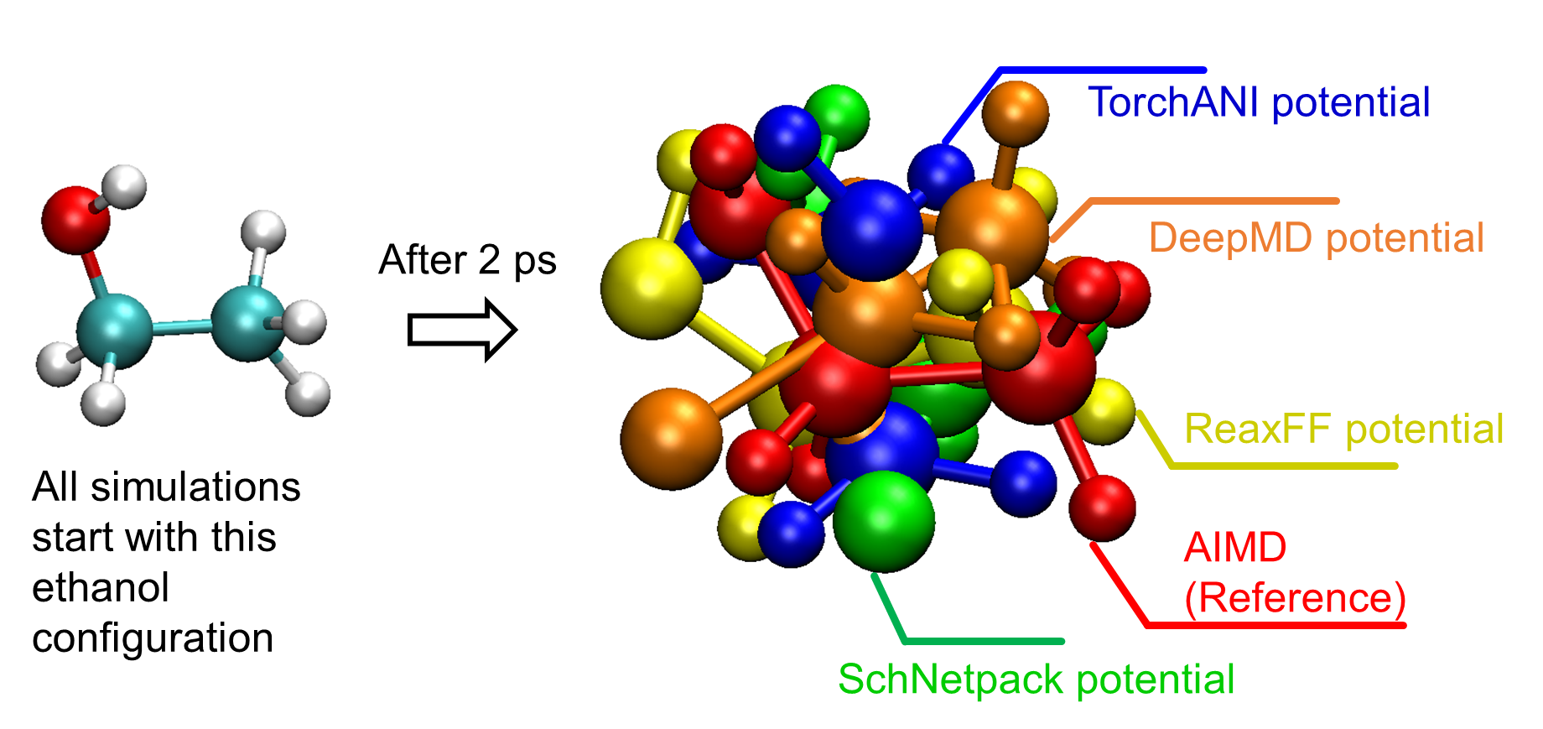
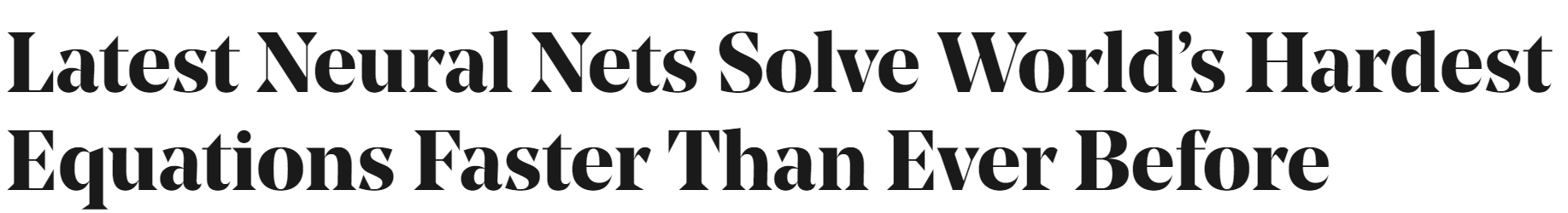
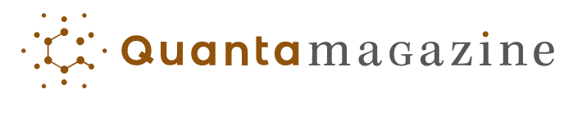
SciML Motivation and Aims
Simulations are crucial for many areas of decision-making and scientific discovery
Need: Improve computational efficiency and scalability for heterogenous scientific simulations
Objectives:
Domain-agnostic software and algorithmic framework
Scientific computing enhanced by data science
Algorithmic speedups enhanced with HPC
Applications: Optimization, modeling and control of dynamical systems (ODE, PDE, DAE, Hybrid systems)

Slide 3

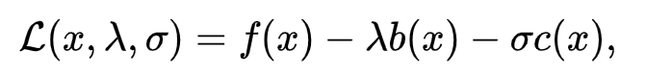
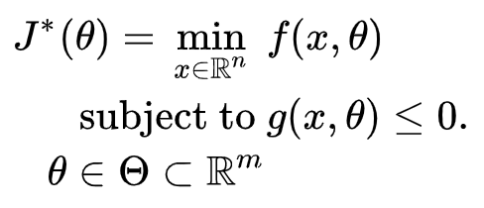

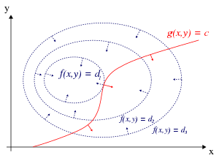
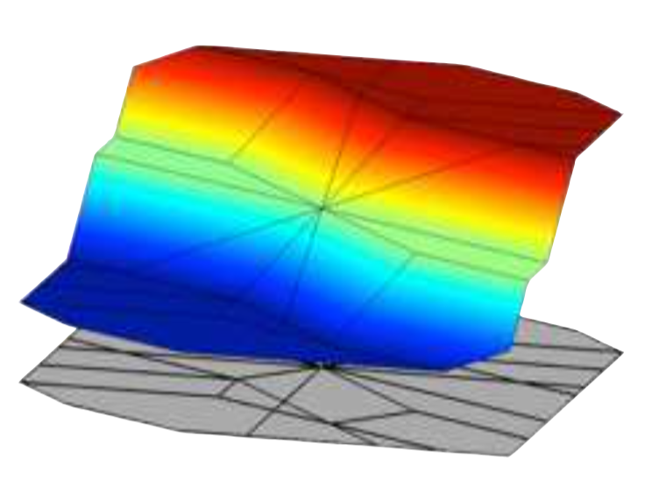


Differentiable Optimization as Lingua Franca for Scientific Computing
Standard form
Lagrangian form
Parametric programming
Machine learning
“online” optimization
single solution for
given parameter values
“online” optimization
using soft constraints
instead of hard constraints
“offline” optimization
obtains a solution map
for a set of parameters classical methods lead to
exponential complexity!
“offline” optimization
obtains a model (map)
for a set of datapoints
scalable but classically
can’t handle constraints
Differentiable parametric programming (DPP): a unifying approach for data-driven parametric programming optimization with solutions based on automatic differentiation (AD)

Slide 4
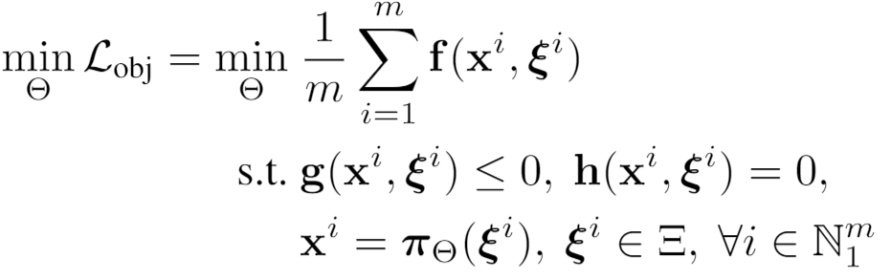
Differentiable Parametric Programming: Generalization of PINNs
Problem formulation:

Slide 5
Differentiable Parametric Programming: Generalization of PINNs
Objective function
Problem formulation:
Constraints
Primal optimizers
Scenarios
Solution map
Parameters

Slide 6
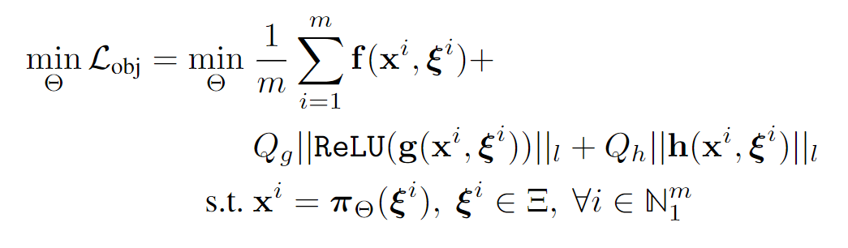
Differentiable Parametric Programming: Generalization of PINNs
Objective function
Problem formulation:
Constraints
Primal optimizers
Scenarios
Solution map
Parameters
Lagrangian form:
Constraints penalties
Gradient-based optimization based on AD

Slide 7
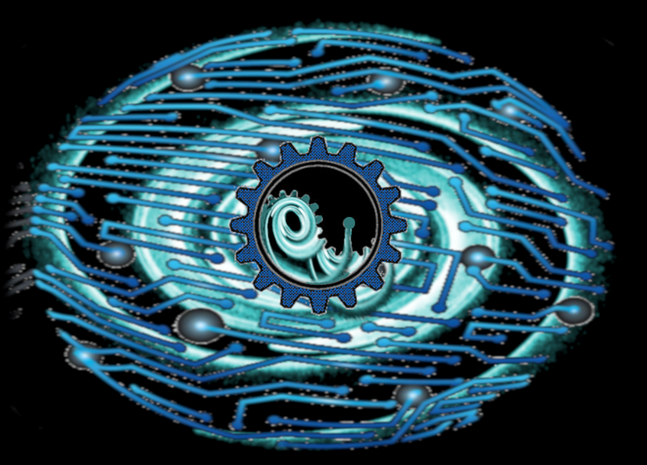

NeuroMANCER Framework
Neural Modules with Adaptive Nonlinear Constraints and Efficient Regularizations
Open-source scientific machine learning (SciML) framework in Python for integrating deep learning, constrained optimization, and physics-based modeling
Current applications
Molecular dynamics
Power systems
Building modeling and control
UAV modeling and control
Methods
Parametric programming (Sensitivity Analysis)
Differentiable programming (Automatic Differentiation)
https://github.com/pnnl/neuromancer

Slide 8
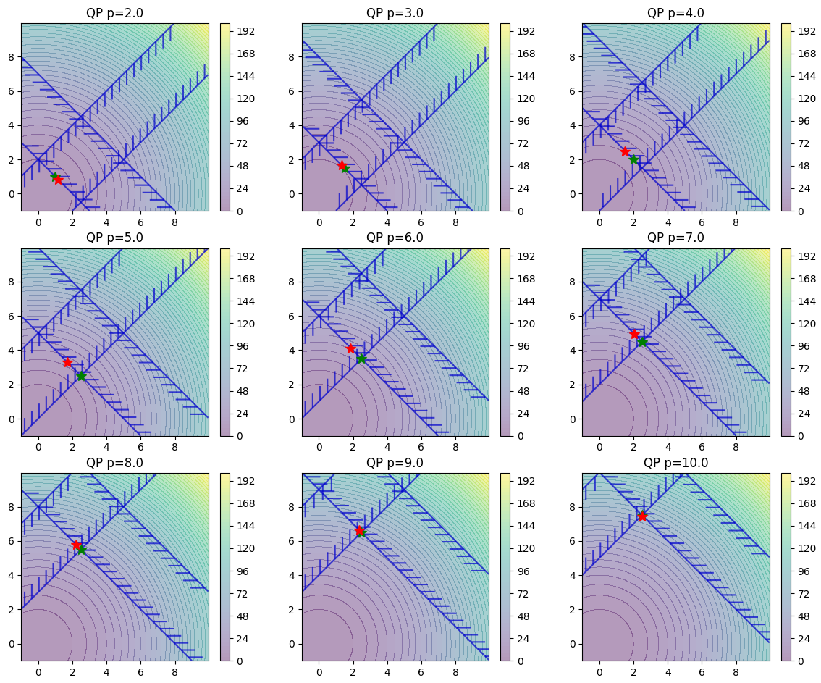
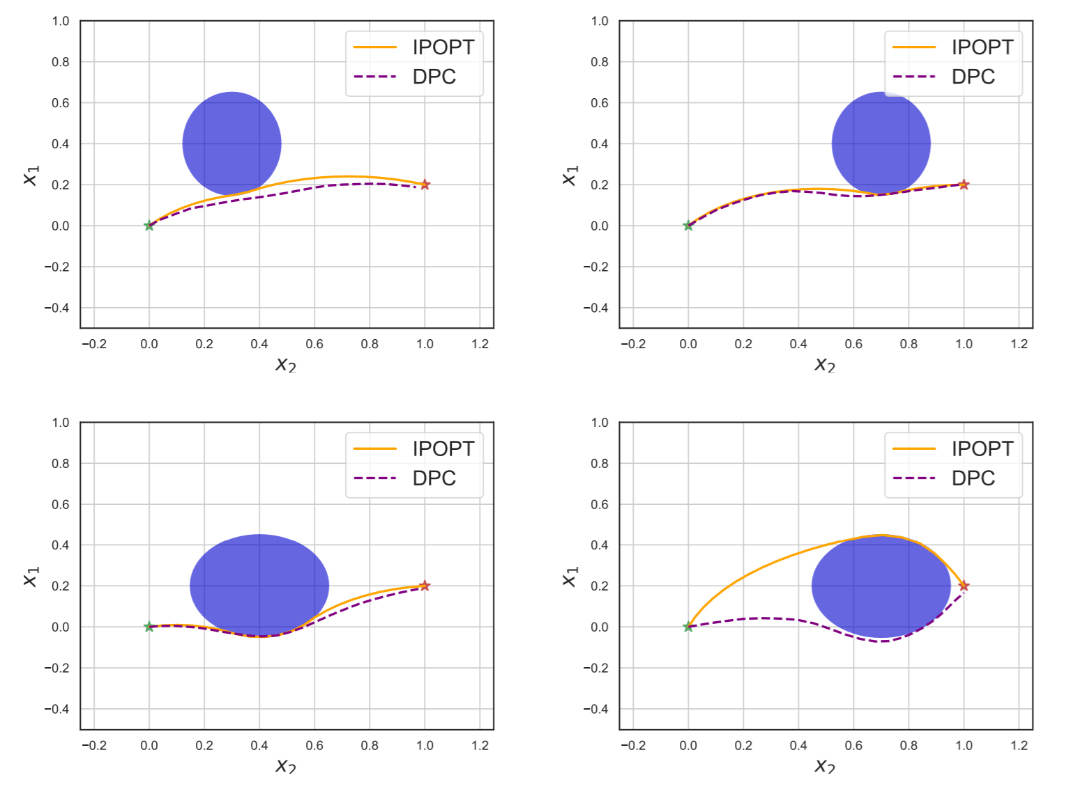
NeuroMANCER Supported Problems
Differentiable constrained optimization
Linear, Quadratic, Nonlinear programs (LP, QP, NLP)
Combinatorial optimization (ongoing)
Constrained machine learning
Deep learning (PINN, structured RNN, MLP, ResNet)
Graph neural nets (GNNs)
Modeling of dynamical systems
Neural state space models (NSSM)
Neural ordinary differential equations (NODE)
Optimal control of dynamical systems
Differentiable predictive control (DPC)
https://github.com/pnnl/neuromancer/tree/master/examples

Slide 9
Part 1: Differentiable Constrained Optimization

Slide 10
Differentiable Constrained Optimization
High abstraction level API in Neuromancer:
train_data, dev_data, test_data = get_dataloaders(samples)
x = Variable(‘x')
y = Variable('y')
p1 = Variable(‘p’)
map = nm.MLP(input_keys=['p’], output_keys=[‘x’,‘y’], name='map’)
f = x ** 2 + y ** 2 obj = f.minimize(weight=Q, name='obj’) con_1 = Q_con*(-x - y + p1 <= 0)
con_2 = Q_con*(-x + y + p1 <= 0)
objectives = [obj]
Constraints = [con_1, con_2] components = [map]
loss = PenaltyLoss(objectives, constraints, train_data) problem = Problem(components, loss) optimizer = torch.optim.AdamW(problem.parameters(), lr=args.lr) trainer = Trainer(problem,train_data,dev_data,test_data,optimizer)
best_model = trainer.train()

Slide 11
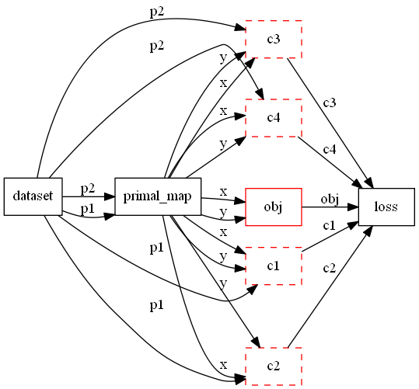
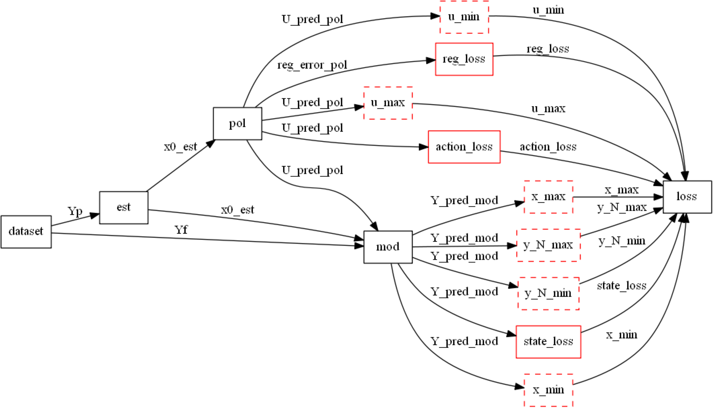
Differentiable Constrained Optimization in NeuroMANCER: Computational Graphs
Multi-parametric quadratic program (mpQP)
Differentiable predictive control (DPC)

Slide 12
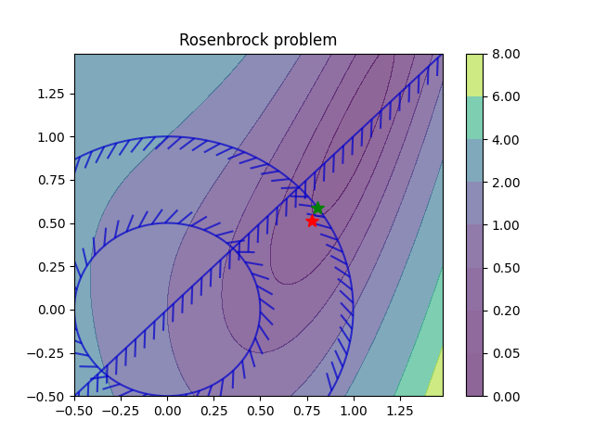
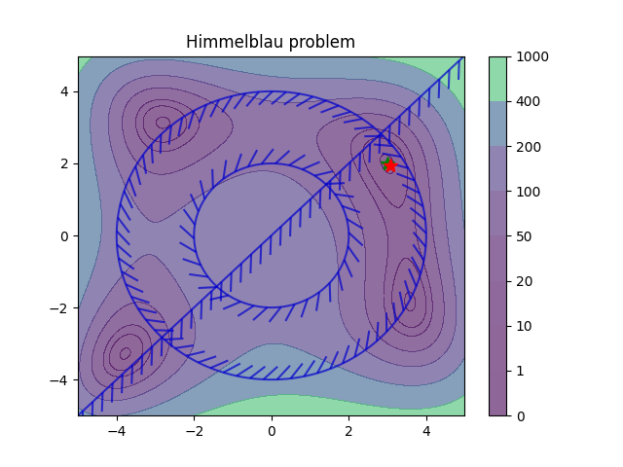
Differentiable Constrained Optimization in NeuroMANCER: Motivating Examples
Orders of magnitude faster online solution compared to online optimization solvers (e.g., IPOPT).

Slide 13
Part 2: Constrained Machine Learning

Slide 14
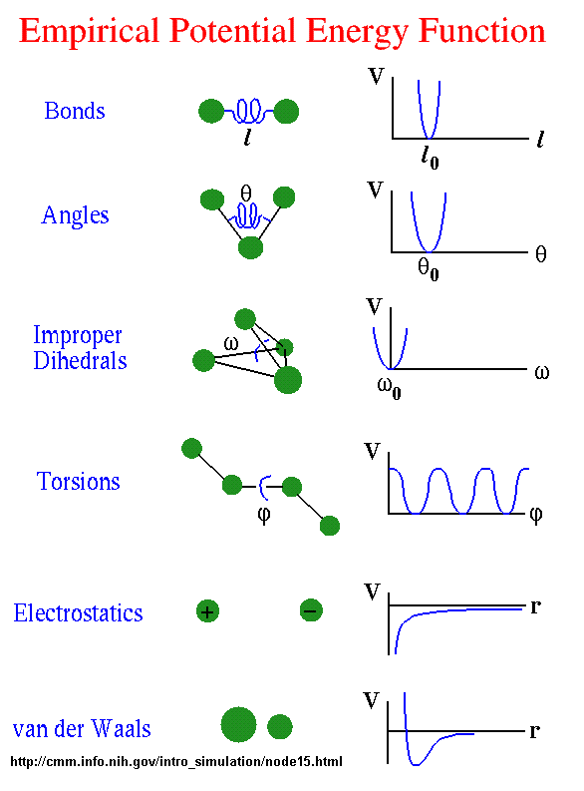
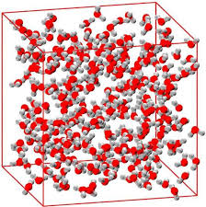
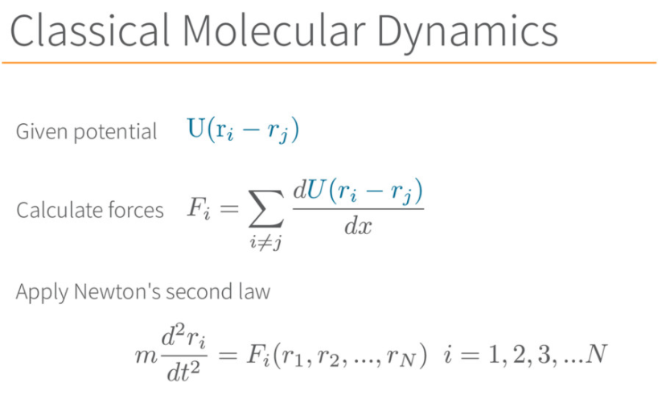
Molecular Dynamics via Empirical Potentials
Energies + forces
[1] Description of Potential Energy Surfaces of Molecules Using FFLUX Machine Learning Models
https://pubs.acs.org/doi/10.1021/acs.jctc.8b00806 [2] Deep Potential Molecular Dynamics: A Scalable Model with the Accuracy of Quantum Mechanics
https://journals.aps.org/prl/abstract/10.1103/PhysRevLett.120.143001
Issues with accuracy

Slide 15
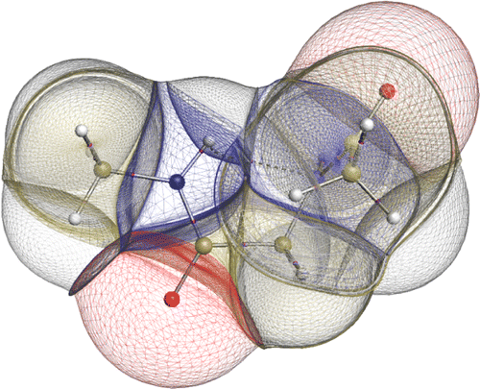
Molecular Dynamics via Quantum Simulations
Quantum mechanics simulations (DFT) [1]
Energies + forces
Issues with scalability
[1] Description of Potential Energy Surfaces of Molecules Using FFLUX Machine Learning Models
https://pubs.acs.org/doi/10.1021/acs.jctc.8b00806 [2] Deep Potential Molecular Dynamics: A Scalable Model with the Accuracy of Quantum Mechanics
https://journals.aps.org/prl/abstract/10.1103/PhysRevLett.120.143001

Slide 16
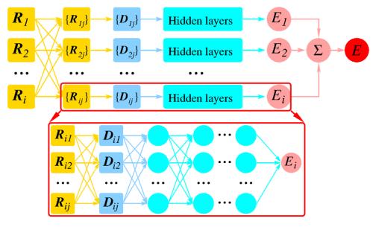
Molecular Dynamics via Deep Potentials
Machine learning-based potential functions [2]
Energies + forces
Issues with generalization and MD simulations
[1] Description of Potential Energy Surfaces of Molecules Using FFLUX Machine Learning Models
https://pubs.acs.org/doi/10.1021/acs.jctc.8b00806 [2] Deep Potential Molecular Dynamics: A Scalable Model with the Accuracy of Quantum Mechanics
https://journals.aps.org/prl/abstract/10.1103/PhysRevLett.120.143001

Slide 17
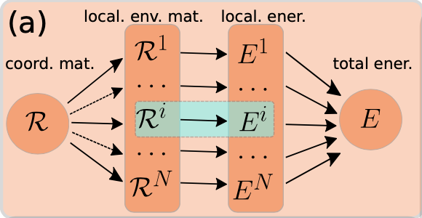
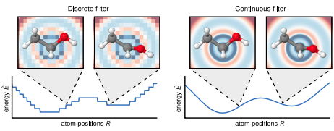
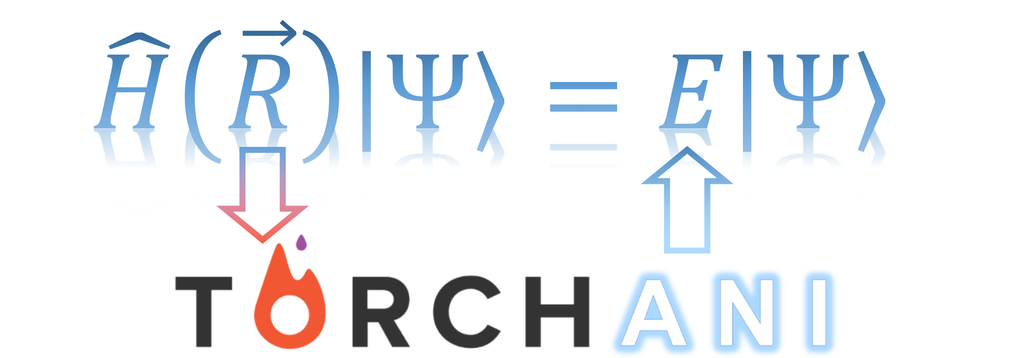
Deep Potential Networks for Molecular Dynamics Simulations
TorchANI [1]
Precomputed Atomic Environment Vectors.
Individual neural networks for each atom type.
Translation and rotation invariant, sometimes permutation invariant.
Deep-Pot SE [2]
Individual neural networks for each pair of atom types.
Translation, rotation and permutation invariant.
Written in C++ and Python.
SchNet [3]
Continuous filter convolutions.
Filter parameters are computed by secondary network.
PyTorchGeometric compatible.
Rotationally invariant energy prediction.
Rotationally equivariant force prediction.
[1] TorchANI: A Free and Open Source PyTorch-Based Deep Learning Implementation of the ANI Neural Network Potentials https://pubs.acs.org/doi/10.1021/acs.jcim.0c00451
[2] End-to-end Symmetry Preserving Inter-atomic Potential Energy Model for Finite and Extended Systems
https://arxiv.org/abs/1805.09003 [3] SchNet: A continuous-filter convolutional neural network for modeling quantum interactions
https://arxiv.org/abs/1706.08566

Slide 18
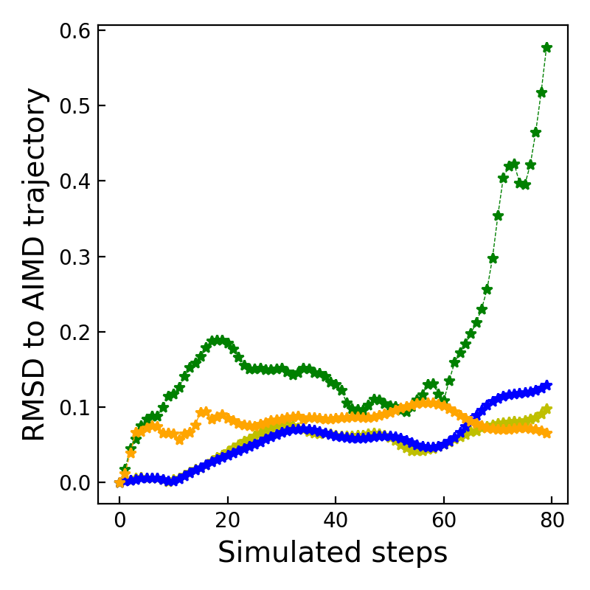
Comparing Deep MD Potential Functions
Bottleneck of static potentials: predicted trajectories diverge from the reference trajectory as time evolves in molecular dynamics simulations. In MD they perform worse than classical potentials.

Slide 19
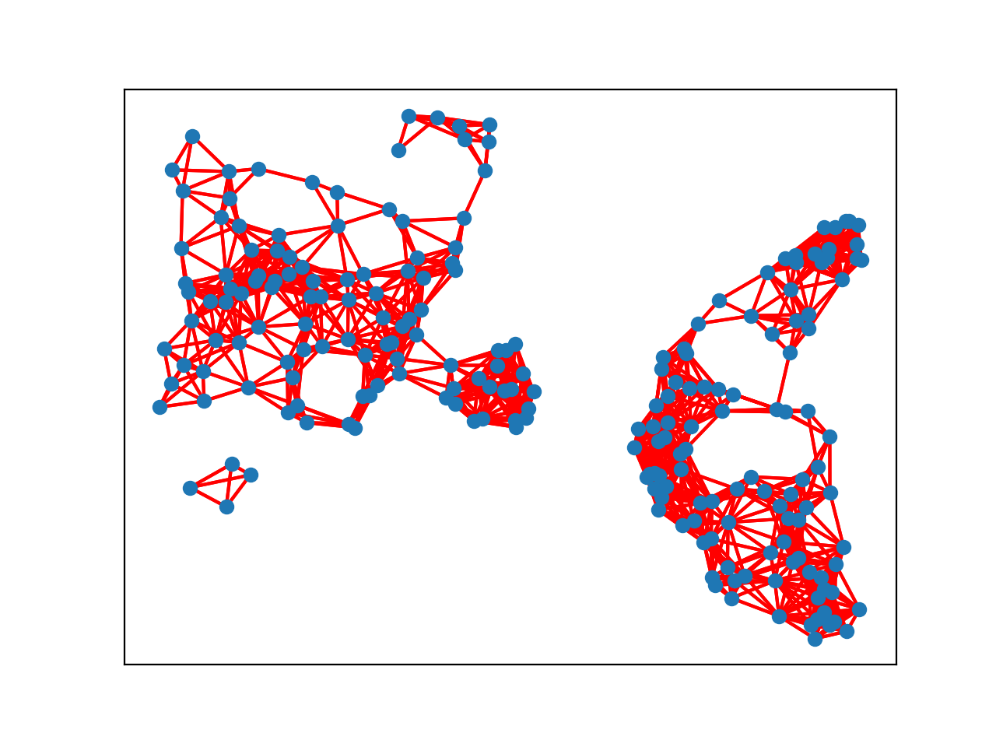
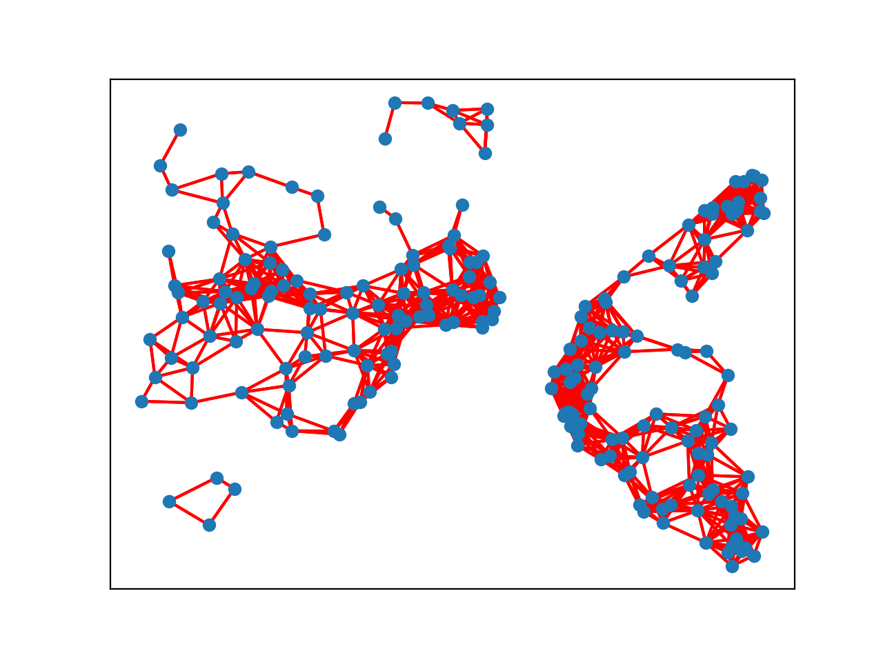
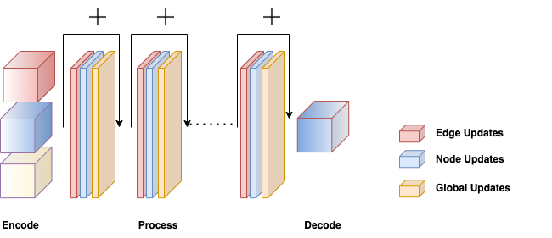
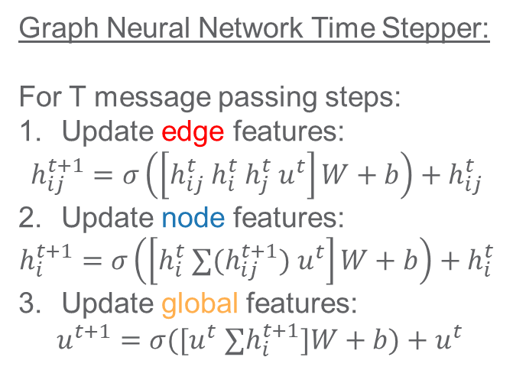
Graph Neural Time Steppers for MD
Idea: Instead of static potential functions, train GNN time steppers on MD trajectories.
Differentiable neural MD
No need for external MD libraries such as LAMMPS
Graph Neural Network Time Stepper:
For T message passing steps:
Update edge features:
$$h_{ij}^{t+1}=σ\left(\left[h_{ij}^{t} h_{i}^{t} h_{j}^{t}{ u}^{t}\right]W+b\right)+h_{ij}^{t}$$
Update node features:
$$h_{i}^{t+1}=σ\left(\left[h_{i}^{t} ∑{(h}_{ij}^{t+1}) u^{t}\right]W+b\right)+h_{i}^{t}$$
Update global features:
$u^{t+1}=σ([u^{t}$ $∑h_{i}^{t+1}]W+b)+u^{t}$
Input Trajectories
Time: 0
Encode Graph
Process Time Stepper
Decode Acceleration
Time: 10
Integrate Position
Notes:
Add waveform figure as a result – copy from previous slide replace discretize linearize with one block as iterative method

Slide 20
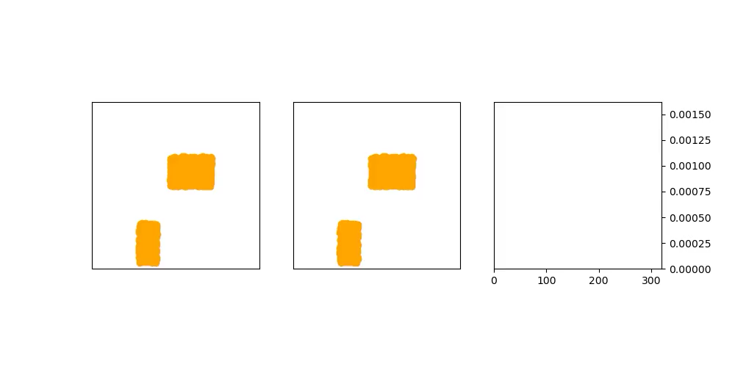
Sand Simulation Rollouts in Neuromancer
GNN Time Stepper
Simulator
Error
MSE
Time
Recreated results from: Learning to Simulate Complex Physics with Graph Networks Alvaro Sanchez-Gonzalez, Jonathan Godwin, Tobias Pfaff, Rex Ying, Jure Leskovec, Peter W. Battaglia, ICML, 2020

Slide 21
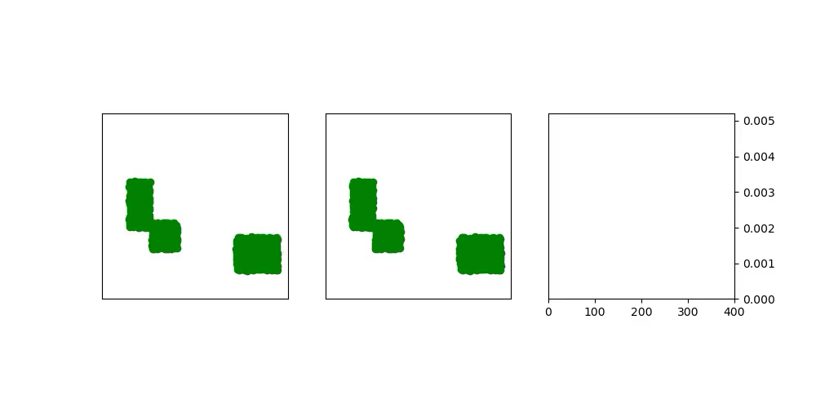
Goop Simulation Rollouts in Neuromancer
GNN Time Stepper
Simulator
Error
MSE
Time
Recreated results from: Learning to Simulate Complex Physics with Graph Networks Alvaro Sanchez-Gonzalez, Jonathan Godwin, Tobias Pfaff, Rex Ying, Jure Leskovec, Peter W. Battaglia, ICML, 2020

Slide 22
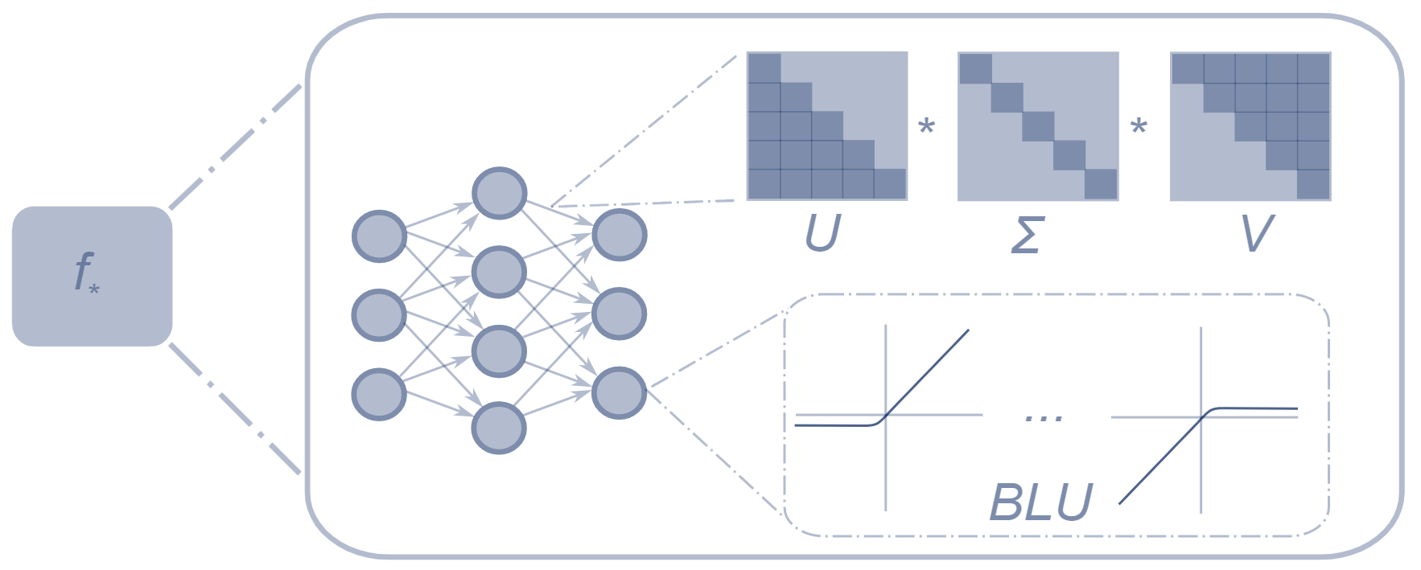
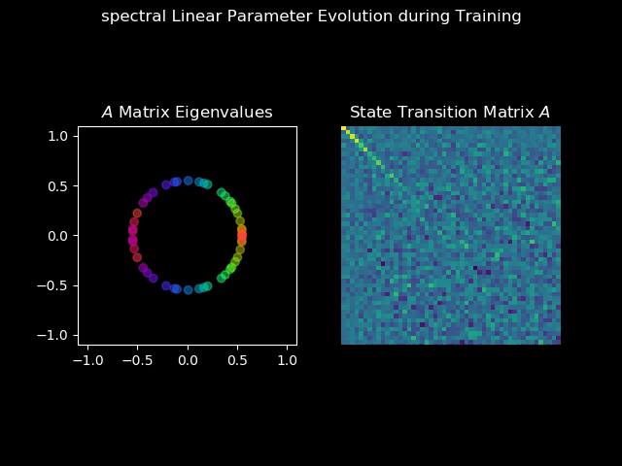
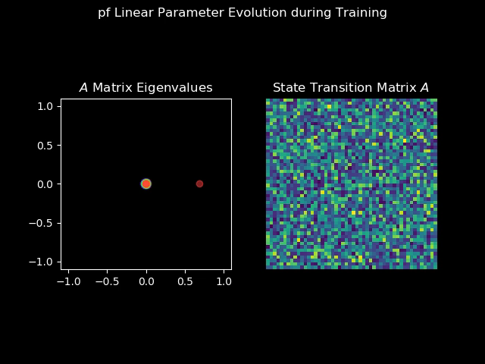
Bottom-Up Approach: Structured Linear Maps (SLiM)
Factorizations and regularizations of linear maps with predetermined structure
Can be used to enforce sparsity or spectral properties
https://github.com/pnnl/slim
Spectral map
Perron-Frobenius map

Slide 23
Part 3: Physics-informed Modeling of Dynamical Systems

Slide 24
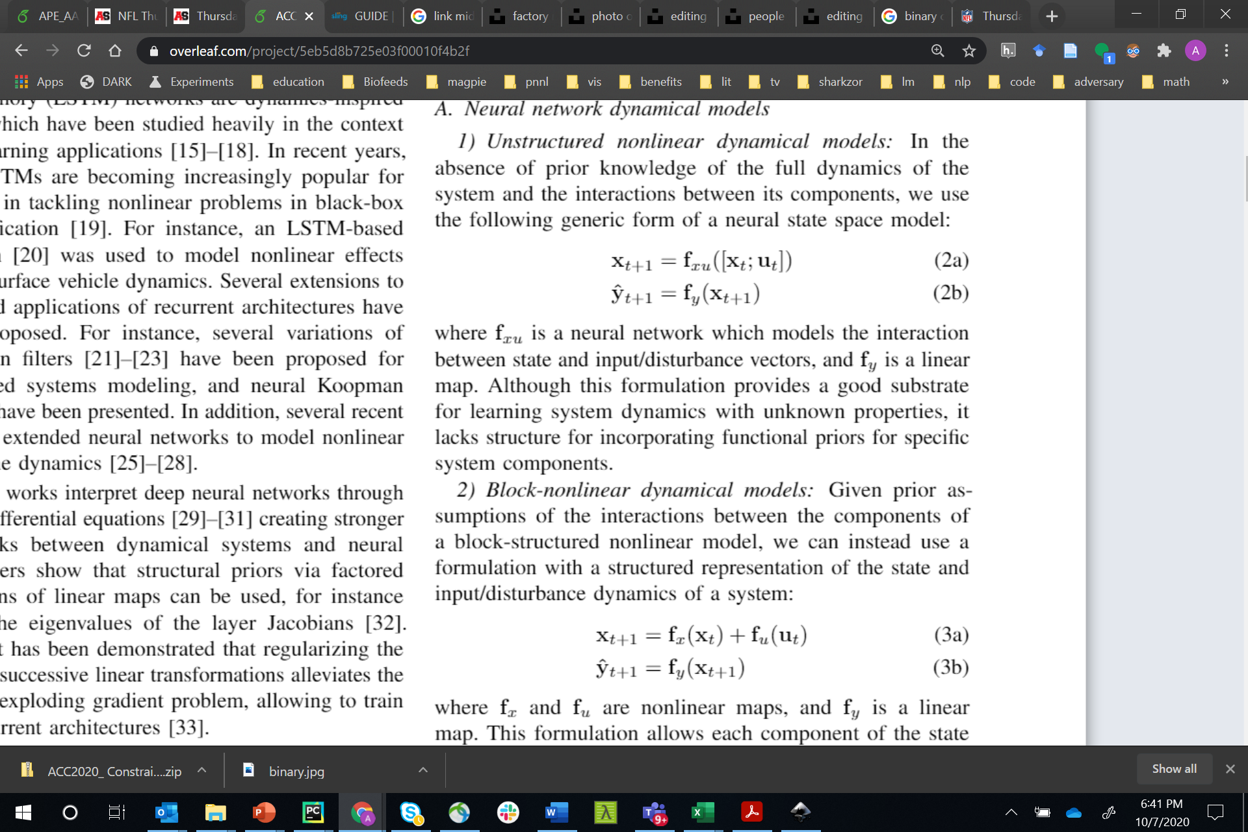
Neural State Space Models
x_{t}
f_{x}
x_{t+1}
f_{y}
x₀
+
y_{t+1}
f_{x}
f_{y}
f_{u}
f_{x}
f_{y}
+
u_{t}
f_{u}
f_{u}
f_{u} o f_{y} = I
Linear
Hammerstein
Koopman
x_{t}
x_{t+1}
y_{t+1}
f_{x}
f_{y}
f_{x}
f_{y}
f_{xu}
f_{y}
+
+
u_{t}
f_{u}
f_{u}
Block-Nonlinear
Unstructured
Hammerstein-Weiner
Linear map
Non-Linear map

Slide 25
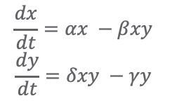
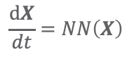
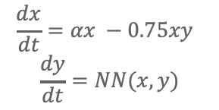
Neural Ordinary Differential Equations
Goal: provide a suite of robust methods for interpretable, data-driven time-stepping
Methods:
Learning flow maps (MLPs and RNNs) for neural ODE implicit layers
ODE solution techniques: RK45, hierarchical, higher-order, implicit, multi-step
Physically-informed models: blend expert knowledge with neural ODE construction
Multi-agent Neural ODEs, Neural PDEs
White-box:
Gray-box:
Black Box:
$$\frac{dx}{dt}=αx −βxy$$
$$\frac{dy}{dt}=δxy −γy$$
$$\frac{dx}{dt}=αx −0.75xy$$
$$\frac{dy}{dt}=NN(x,y)$$
$$\frac{dX}{dt}=NN\left(X\right)$$
Applications: Grid infrastructure, molecular dynamics, damped-driven systems, seismic responses, building thermal dynamics, UAVs, etc.

Slide 26
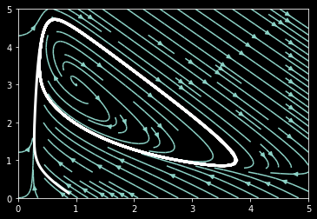
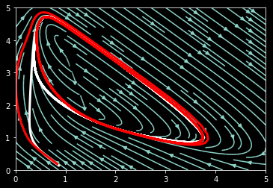
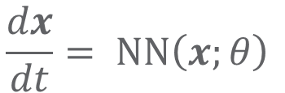
Neural ODE with Runge-Kutta Integration
Data: Brusselator oscillator
$$\frac{dx}{dt}= NN\left(x;θ\right)$$
Black-box neural ODE*:
Ground-truth limit cycle
*NODE architecture is 2x10 MLP with Leaky ReLU activation.
Red: model limit cycle

Slide 27
Part 3: Constrained Control of Dynamical Systems

Slide 28
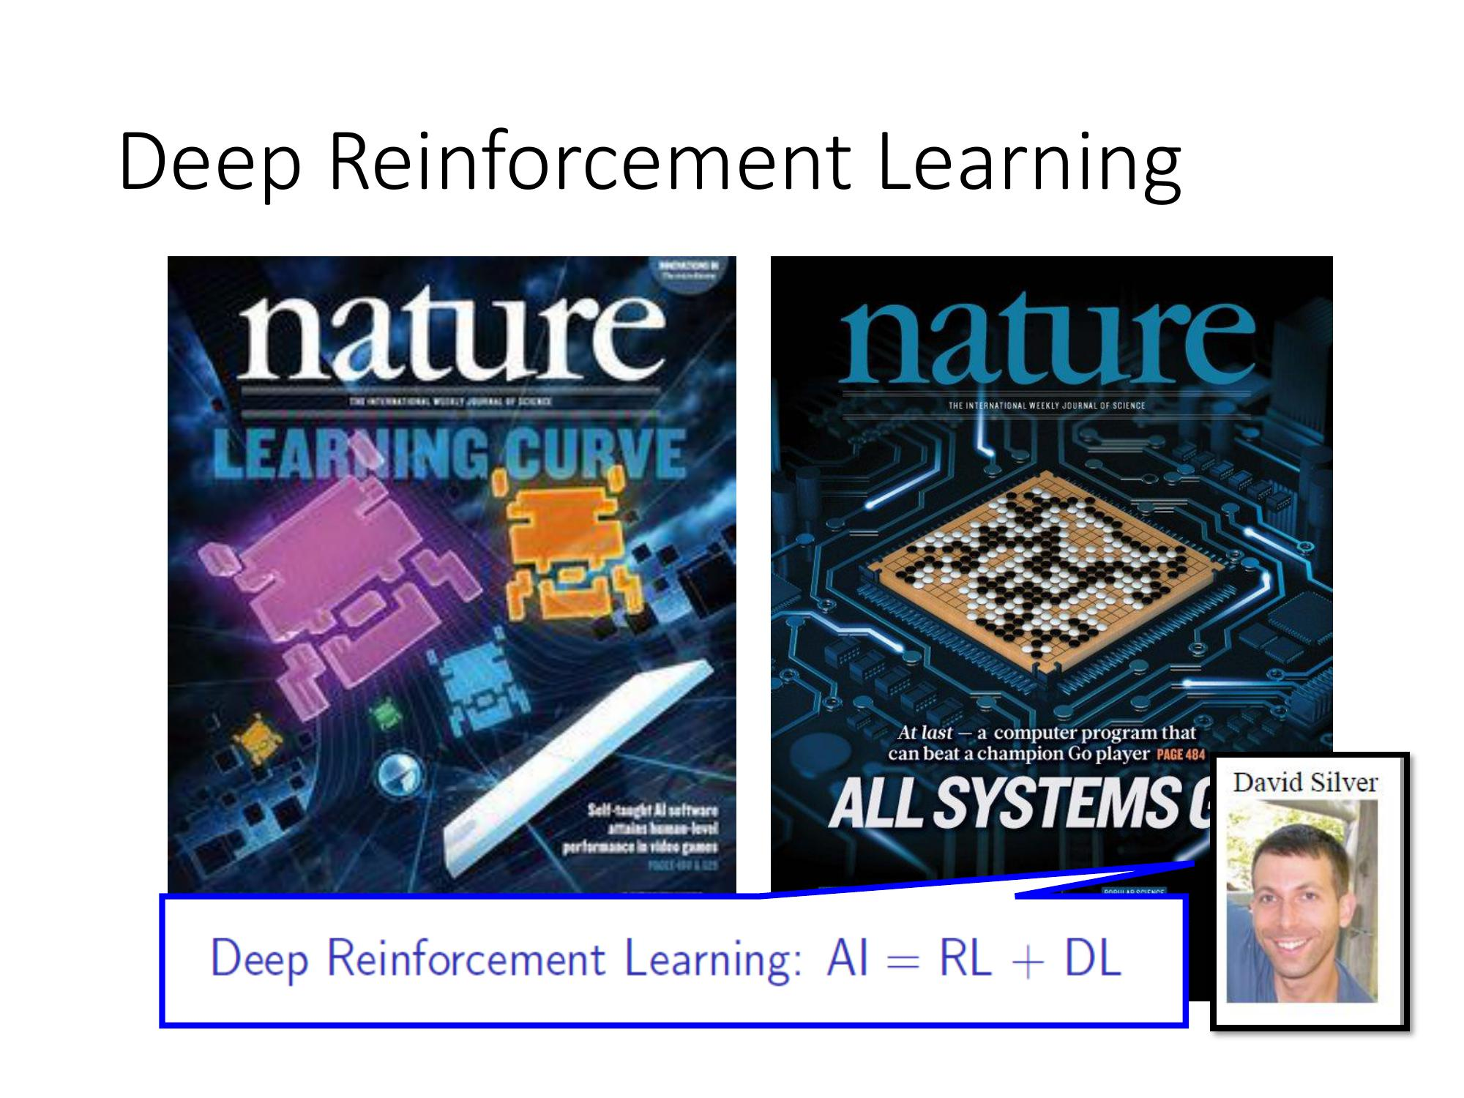
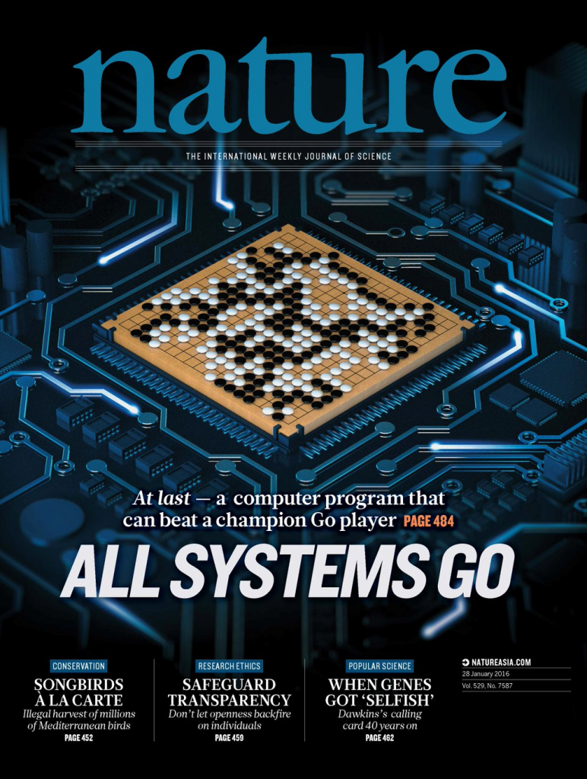
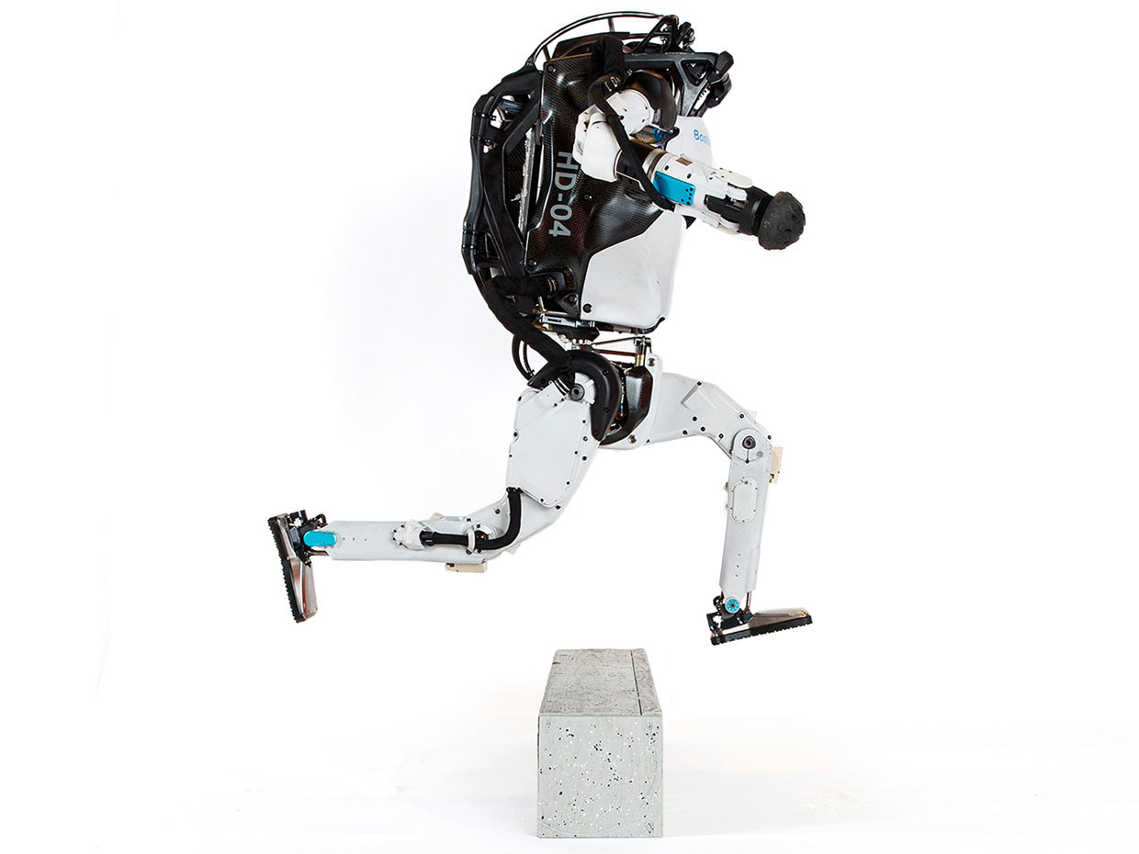
Model Predictive Control vs Deep Reinforcement Learning
MPC
RL
95% of the industrial control applications are PID loops & expert driven rule-based control (RBC).
The rest is model predictive control (MPC).
Everywhere where you have reliable digital environment model, mostly discrete action space, and you can use massive compute to solve the problem.
Drgona J., J. Arroyo, I.C. Figueroa, D. Blum, K. Arendt, D. Kim, and E.P. Olle, J. Oravec, M. Wetter, D. L. Vrabie, L. Helsen. 2020. "All You Need to Know About Model Predictive Control for Buildings." Annual Reviews in Control, September 29, 2020
G. Dulac-Arnold, D. J. Mankowitz, and T. Hester, “Challenges of real-world reinforcement learning,”, 2019.
http://arxiv.org/abs/1904.12901

Slide 29
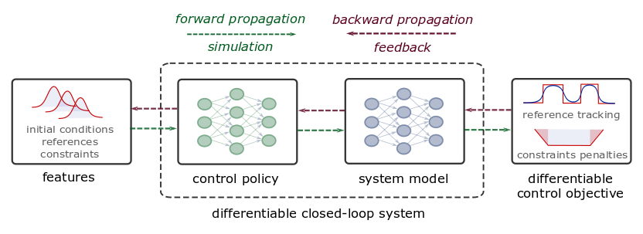
Differentiable Predictive Control
Constrained Model-based Policy Optimization for Parametric Optimal Control
Jan Drgona, Aaron Tuor, Draguna Vrabie, Learning Constrained Adaptive Differentiable Predictive Control Policies With Guarantees
https://arxiv.org/abs/2004.11184
Jan Drgona, et al., Differentiable Predictive Control: An MPC Alternative for Unknown Nonlinear Systems using Constrained Deep Learning https://arxiv.org/abs/2011.03699

Slide 30
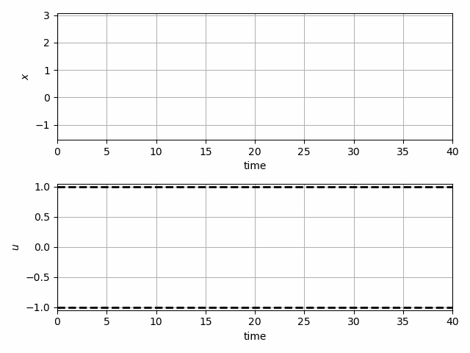
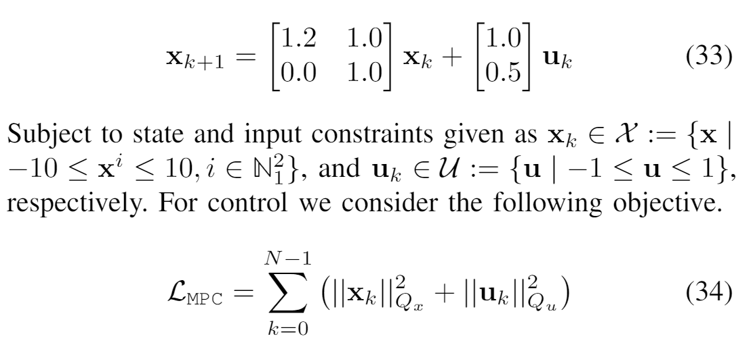
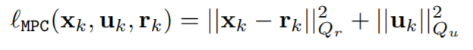
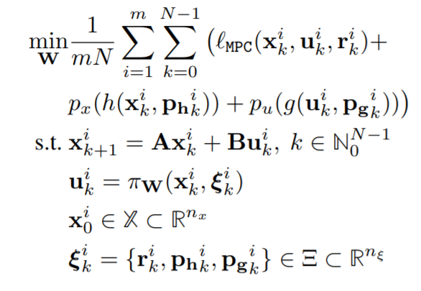
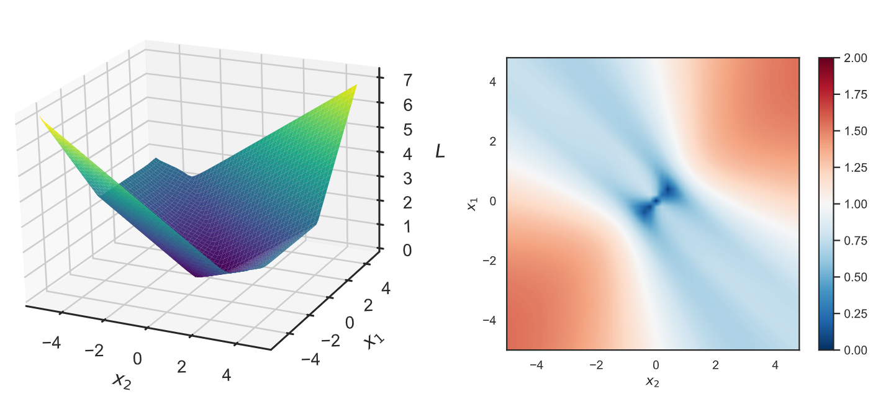

Learning to Stabilize Unstable System
Problem setup:
DPC formulation:
Jan Drgona, Aaron Tuor, Draguna Vrabie, Learning Constrained Adaptive Differentiable Predictive Control Policies With Guarantees, https://arxiv.org/abs/2004.11184

Slide 31





DPC Policy Gradients and Optimization
Policy
Reward function
Constraints
penalties
Direct policy gradients

Slide 32


Dynamics of DPC Control Policy Learning
1341 learning parameters, 48.2 seconds offline training time on a CPU with 200 epochs.
Jan Drgona, Aaron Tuor, Draguna Vrabie, Learning Constrained Adaptive Differentiable Predictive Control Policies With Guarantees, https://arxiv.org/abs/2004.11184

Slide 33




Stochastic Parametric Differentiable Predictive Control
Stochastic Parametric Reward Function
Parameters
Uncertainties
Sensitivities
Jan Drgona, Sayak Mukherjee, Aaron Tuor, Mahantesh Halappanavar, Draguna Vrabie, Learning Stochastic Parametric Differentiable Predictive Control Policies, under review for IFAC ROCOND 2022

Slide 34

Stochastic Parametric Differentiable Predictive Control
Stochastic Parametric Reward Function
Parameters
Uncertainties
Sensitivities
Jan Drgona, Sayak Mukherjee, Aaron Tuor, Mahantesh Halappanavar, Draguna Vrabie, Learning Stochastic Parametric Differentiable Predictive Control Policies, under review for IFAC ROCOND 2022

Slide 35



Economic Differentiable Predictive Control of Building Energy System
Neural state space dynamics model
MLP control policy architecture
Results
Handling multi-input multi-output nonlinear dynamics
Dynamic economic control objective
Parametric constraints
Jan Drgona, Aaron Tuor, Elliott Skomski, Soumya Vasisht, Draguna Vrabie, Deep Learning Explicit Differentiable Predictive Control Laws for Buildings, IFAC NMPC 2021

Slide 36


Dynamics-Aware Economic Redispatch via Differentiable Predictive Control
Problem: Current redispatch processes do not incorporate system dynamics concerns. Incorporating dynamics in redispatch is too complex and/or time-consuming
Architectures
Koopman dynamics model
CNN control policy
Solution: Machine-learning based dynamics-aware redispatch. Learn system dynamics for faster assessment.
Results
5 orders of magnitude speed-up
Minimal loss in solution quality
Ethan King, Ján Drgoňa, Aaron Tuor, Shrirang Abhyankar, Craig Bakker, Arnab Bhattacharya, Draguna Vrabie, Koopman-based Differentiable Predictive Control for the Dynamics-Aware Economic Dispatch Problem, The 2022 American Control Conference (accepted)
Notes:
Add waveform figure as a result – copy from previous slide replace discretize linearize with one block as iterative method

Slide 37
Embedded Implementation of DPC
Flexy-Air system sketch with Raspberry-Pi controller
Performance comparison: reference (red dashed), position controlled with PI controller (green), explicit model predictive control (purple), constrained differentiable predictive control (blue) and constraints (black-dashed). Bottom figures show the fan speed controls
Jan Drgona, Karol Kis, Aaron Tuor, Draguna Vrabie, Martin Klauco, Differentiable Predictive Control: An MPC Alternative for Unknown Nonlinear Systems using Constrained Deep Learning; arXiv:2011.03699

Slide 38






Conclusion
NeuroMANCER
Differentiable programming
Parametric programming
Constrained optimization
Dynamical modeling and control
Ongoing work
Constrained optimization solvers
Graph neural networks (GNNs)
Mixed-integer programs (MIP)
Uncertainty Quantification (UQ)
Long-Term Vision
Causal discovery, dynamical coupling, sensitivity, structure, and stability analysis, machine reasoning
Solving large-scale non-convex parametric constrained optimization problems
https://github.com/pnnl/neuromancer
https://github.com/pnnl/slim

Slide 39
Additional details on Neuromancer Technology

Slide 40

NeuroMANCER Library
Notes:
Add waveform figure as a result – copy from previous slide replace discretize linearize with one block as iterative method

